Slide 1
MAC2303
ภาษาอังกฤษสำหรับการจัดการเรียนรู้คณิตศาสตร์
(English for Mathematical Learning Management)
Math Vocabulary in High School
By Suranon Yensiri

Slide 2
What is the term used to describe something exactly equal in size and shape?
Perpendicular
Symmetry
Transformation
Congruence
Reflection

Slide 3
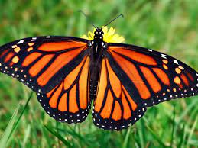
What word is use to describe the distance around the circle?
Area
Radius
Arc
Perimeter
Circumference

Slide 4
A number that cannot be expressed as the ratio of two integers is called what?
Whole number
Integer
Rational number
Irrational number
Complex number

Slide 5
What term describes a line with zero slope?
Polynomial
Hypotenuse
Vertical
Horizontal
Parallel line

Slide 6
What is numeral words that indicate order such as first, second and third?
Natural number
Cardinal number
Ordinal number
Algebraic number
Prime number

Slide 7
Which term defines the number that has to be multiplied itself to equal a given number ?
Exponent
Root
Nominator
Denominator
Coefficient

Slide 8
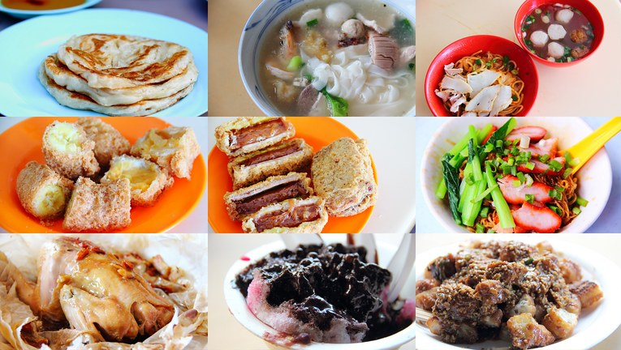
How many prime numbers are there from 1 to 50 ?

Slide 9
Paraphrase
What is an arithmetic mean?

Slide 10
Draw a graph
Plot $y={−x}^{2}+3$

Slide 11
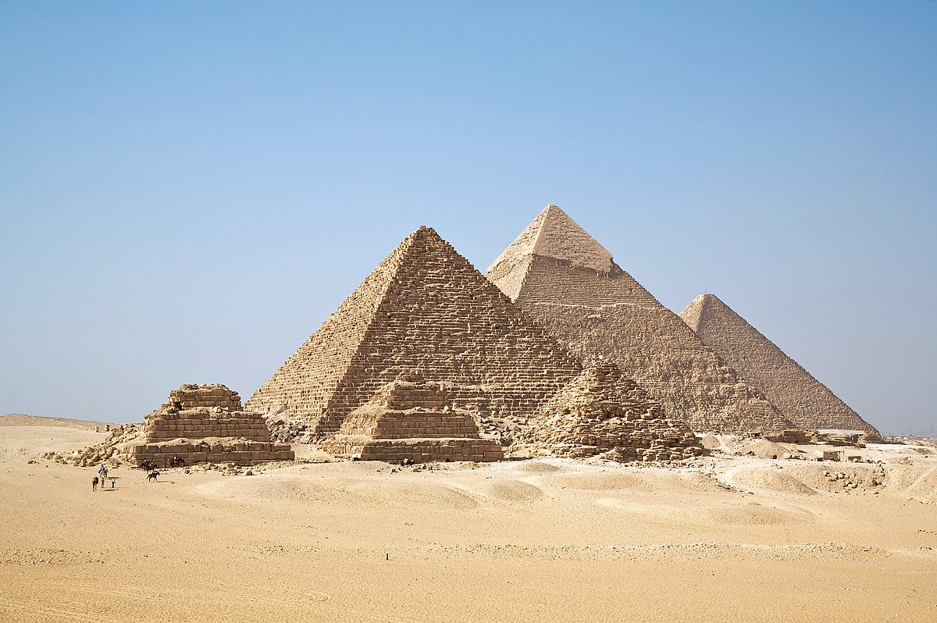
Image upload
Show a real-life example of Prism

Slide 12
Activity 1 : FOIL Method

